Slide 1
Year 3 Inspire
Welcome to our inspire session

Slide 2
CPA approach
In Maths we use a CPA approach.
Concrete – children can learn new concepts by using concrete materials such as base 10 materials
Pictorial – children will apply skills/explore concepts using picture representations such as place value charts or a part whole model
Abstract – this is the Maths you’re probably most familiar with. This is calculations and problem solving represented by numbers

Slide 3
Why Mental Maths?
It’s important the children have good mental maths skills as this is the foundation of all Maths and will support them with solving more complex maths problems.
By giving children the tools that they need to master mental maths, you're opening up a world of possibilities and giving them a great deal of independence. It also improves their memory skills, which will benefit them in all aspects of their learning journey. Mental maths is the key to confidence and fluency.

Slide 4
Let’s practise – number bonds
2
4
8
3
9

Slide 5
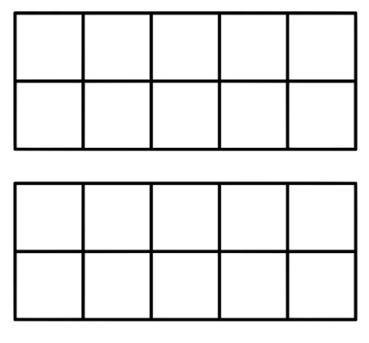
Addition
Number bonds can help us mentally add
36 + 7 =
4
3
+ 4
+ 3
36
40
43

Slide 6
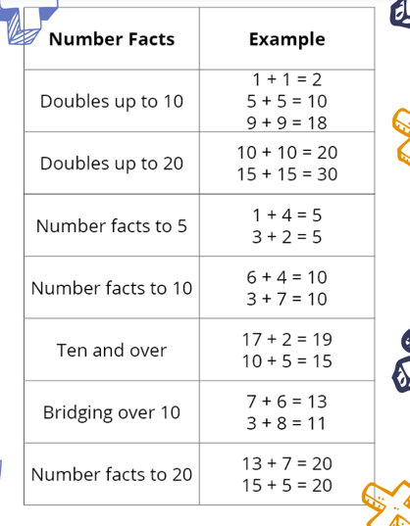
Important mental maths skills
Number bonds
Doubles and halves
Times tables and related division facts
Addition and subtraction

Slide 7
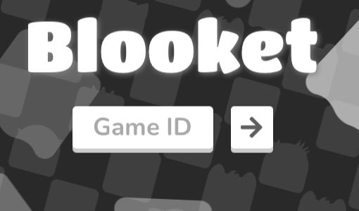
Blooket
Let’s play a game:
https://www.blooket.com/

Slide 8
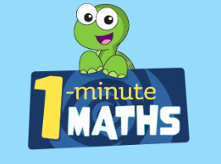
White rose 1 minute Maths
https://assets.whiteroseeducation.com/secure/digital-tools/1-minute-maths/index.html?_gl=1*12sfv8w*_ga*MzE0MDExNDQ5LjE2ODgzODM4MTY.*_ga_869Y76J73T*MTY5ODUyMTAzMS4yMi4xLjE2OTg1MjEwNjkuMC4wLjA.

Slide 9
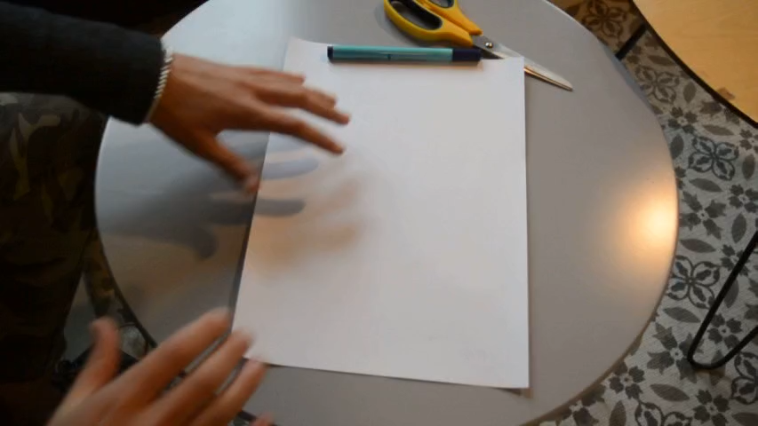
3 minute Maths paper flip

Slide 10
Use your paper flips to practise your Maths facts or choose a Maths game from the table to play. Have fun!

