Slide 1
Year 4 INSPIRE
Thursday 12th October

Slide 2
What’s it about?
Today is an opportunity to get a snippet of what we do in school, and to help give you some ideas of ways to help your children at home.

Slide 3
Why times tables?
In June, all children will take a times tables test. They have 6 seconds to answer each question and each question will be random.

Slide 4
Chanting
The easiest and simplest way to practice our times tables is chanting.
0 x 4 = 0
1 x 4 = 4
2 x 4 = 8
3 x 4 = 12
4 x 4 = 16
5 x 4 = 20

Slide 5
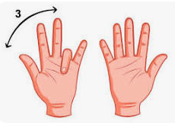
9 x table finger rule

Slide 6

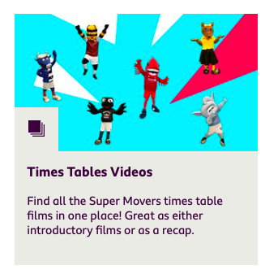
https://www.bbc.co.uk/teach/supermovers

Slide 7
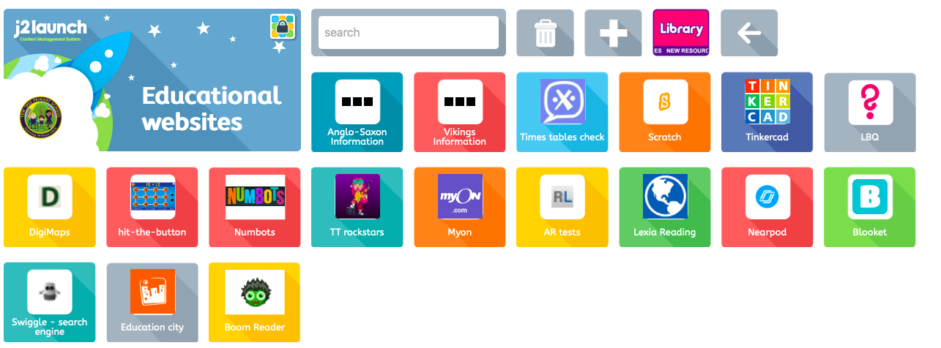

Top Marks
https://www.topmarks.co.uk/maths-games/hit-the-button

Slide 8
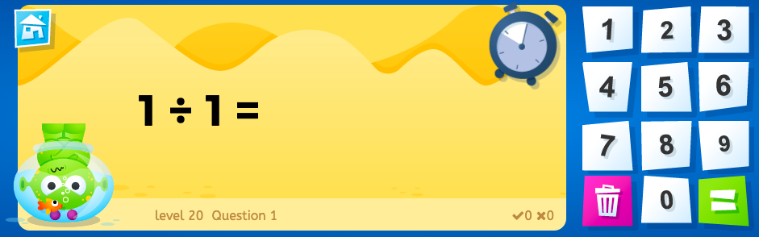
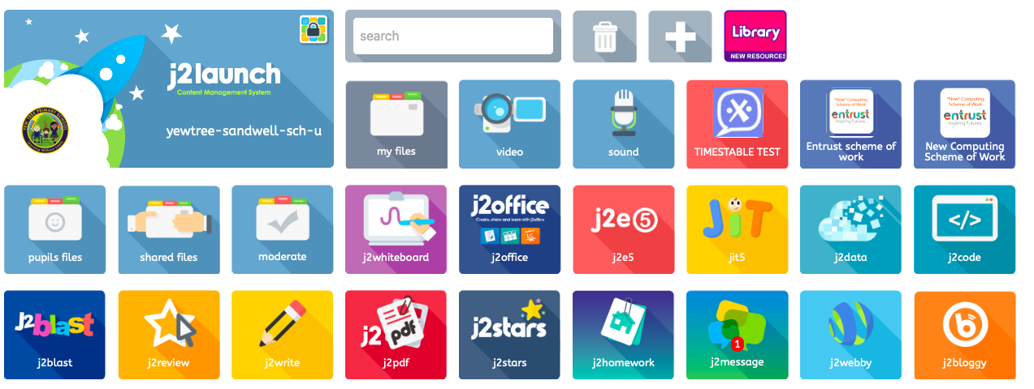
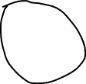
J2Blast

Slide 9

MTC
https://talkingtimestables.uk/y4_ks2_mtc_practice_tests_multiplication_tables_check.php

Slide 10
Activity
This morning, we are going to do 2 activities with the children, both of which you can take home and repeat.

Slide 11
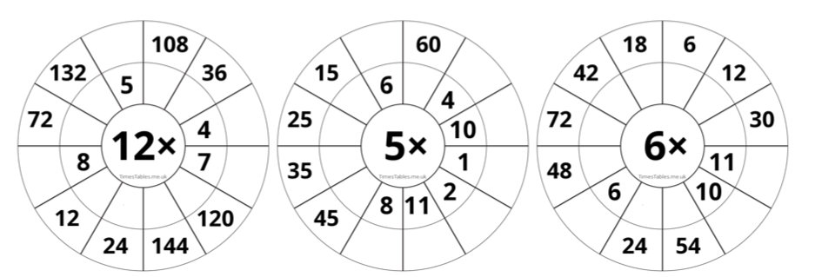
Times Table wheels

Slide 12
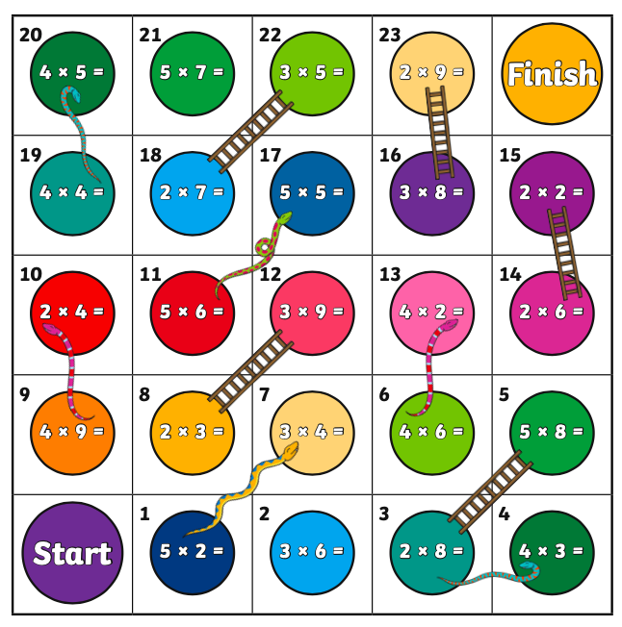
Snakes and ladders

Slide 13
Blooket
Now for a competition
Are you up for the challenge?

Slide 14
Thank you
On behalf of Year 4, we would like to thank you for all coming today and your continued support.
Are there any questions?

