Slide 1

Welcome to our reading workshop
Yew Tree Primary School

Slide 2
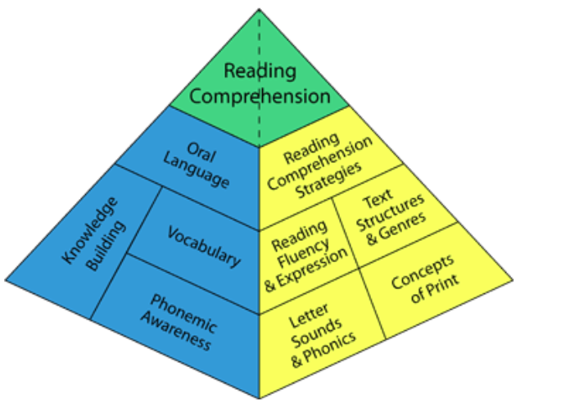
Although the fundamental goal of reading is to understand or make meaning of the text, reading proficiency involves skills in a number of domains.
As illustrated in the pyramid, the building blocks of reading comprehension can be divided into two main groups: print-related skills (yellow components) and language-related skills (blue components).
A balanced literacy diet
All of these domains are explicitly taught in the EYFS but there are some things that you can do at home to help your child in learning to read and helping to foster a love of reading.
Vocabulary
Phonics
Notes:
The print-related components are those that promote a student’s ability to recognize words. To identify words, students need to: develop knowledge of the way print works (Concepts of Print), become aware of the individual sounds in words, learn to recognize each letter of the alphabet, and understand the connections between the sounds in words and the letters used to represent the sounds (the Alphabetic Principle). The language-related components of the pyramid support a student’s ability to make meaning of text. Students need to develop their knowledge of the world around them (Background Knowledge) and their ability to comprehend spoken language (developing their vocabulary knowledge, their understanding of grammar).

Slide 3
Word Awareness

Slide 6
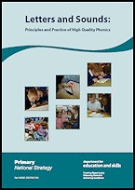
Welcome to
Fun with Phonics!

Slide 7
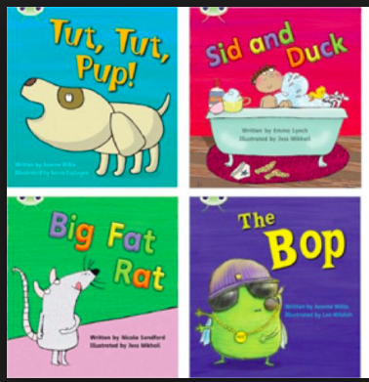
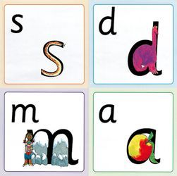
What is it? and
How do we teach it?
Phonics is a strategy that children are taught in helping them learn to read. It runs alongside other teaching methods such as Guided Reading and Shared Reading to help children develop all the other vital reading skills and to hopefully give them a real love of reading.
Phonics is one of the tools we use to support children in learning to read (remember the pyramid)
Children learn letter sounds through actions, pictures, stories and sounds.
Children are then taught to blend these individual sounds together to read.

Slide 8
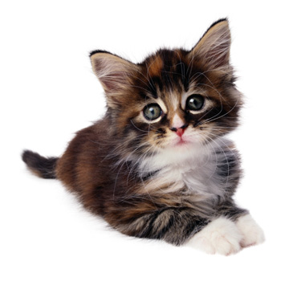
What is a phoneme?
It’s a unit of sound.
In the word cat there are 3 phonemes.
C a t

Slide 9
The first sounds…
We teach the sounds not the letter names.
The first set of sounds we teach are:
s a t p i n
It is important to teach children to pronounce a phoneme correctly.
Pure sounds are pronounced without the ‘uhh’.

Slide 10


Making words
Once children know the first set of sounds they can start blending the sounds together to make words.
sat pat pin tin tap sap sip pip tip pat nip
Children are taught to run the sounds together. We often refer to this as ‘blending’.

Slide 11
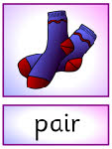
Where it gets a bit tricky…
There are 42 phonemes to teach in total.
Some of these phonemes are made up of more than one letter for example…
ai as in rain oa as in boat
sh as in shop air as in pair
These need to be taught as one sound as in the examples below
P air r ai n

Slide 12


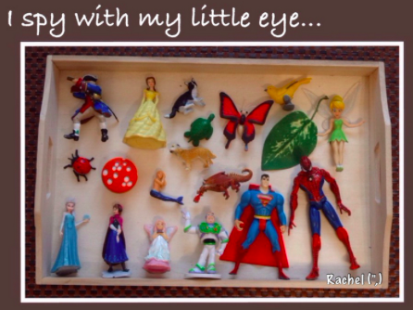

What we want you to do…
Listen!
Help your child to listen and isolate a range of sounds by playing listening games, singing nursery rhymes, making animal noises, clapping out syllables and listening to music and stories.

Slide 13

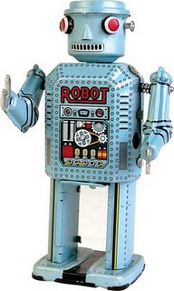





What we want you to do…
Be a robot!

Slide 14
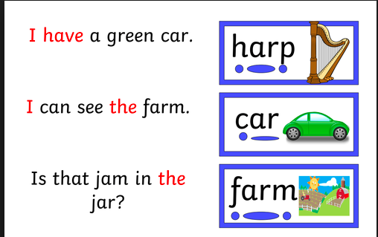
Use your sound buttons!
What we want you to do…

Slide 15

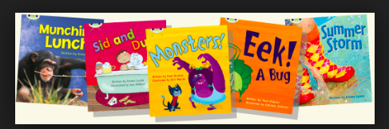
What next….
In class tomorrow we will be having a book day. Your child will participate in lots of reading activities including some of the things we have talked about this evening.
They can bring in their favourite book from home to share with their peers.
At the end of the day we will issue each pupil with a book bag, a reading journal and their first school reading book.
THIS MUST BE BROUGHT INTO SCHOOL EVERYDAY.

Slide 16
Thank you!!!
Thank you for showing your enthusiasm for your child’s learning by coming to this workshop
We want to work together to provide the best learning for your child
Further help…
On the school website you will find links to websites that will help you support your child with their phonics and early reading.

